Slide 1

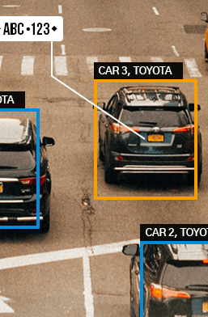
Automatic Number Plate Registration System :
Presented by :
Dharjinder Singh (5 1 2 5)
Harernder singh (5 1 2 6)
Manish singh Nagarkoti (5 1 3 4)
Nirmat singh (5 1 4 0)

Slide 2
Acknowledgement :
We appreciate Mrs. Mridula Chandola, our faculty coordinator, Dr. Swati Kulkarni, our Head Of Department, and Dr. B.P. Patil, our principal, for their help and direction in the progress of our project on the Automatic Number Plate Registration System. It was a fantastic learning opportunity. Without their assistance and feedback, it would be impossible for us to proceed with this project.

Slide 3
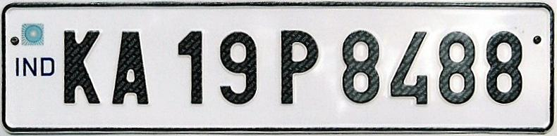
Objective:
In this project, we will create a system that can scan the license plate of any unregistered car entering our campus and register it in our database; once the vehicle leaves the region, it will then be unregistered once more.

Slide 4
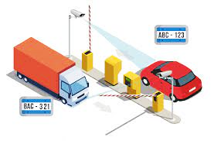
Benefits From This Project :
This will enable us to monitor the movement of cars into and out of our campus.
Compared to the manual way, it will be simpler, quicker, and superior.
We will have better records on unauthorized vehicles entering our campus.
After the specified period, we will be able to check whether any unauthorized vehicles are present inside our institution.

Slide 5
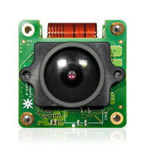
DETAILS :
In this project we will be using Python language.
As with the help of Python language is able to easily scan an image and extract data from the image.
For extraction data from images we will be using the Open CV library.
Open CV will be able to recognize the correct position of the car number plate.
We will be using IMUTILS with Open CV for image processing.

Slide 6
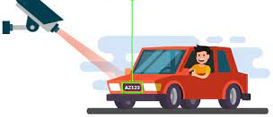
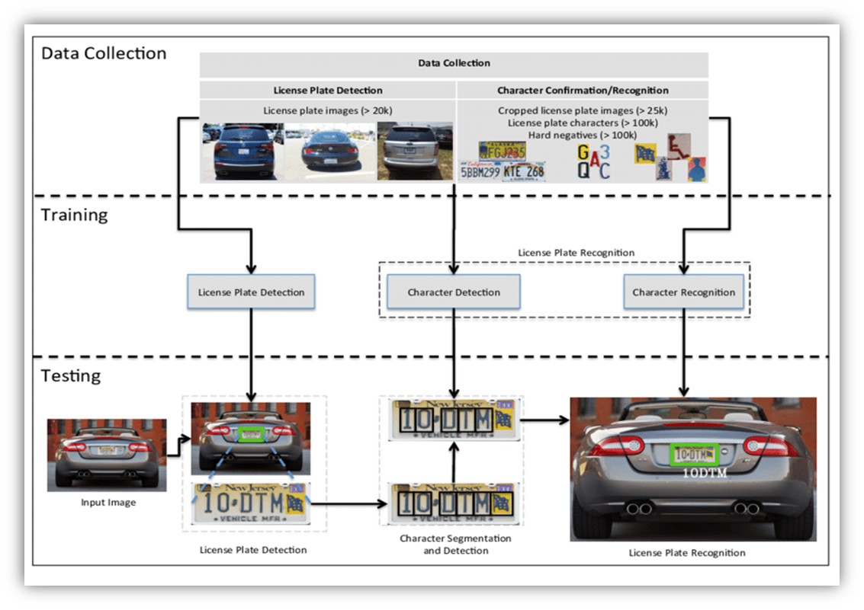
Then we will be using OCR libraries which will help us to recognize the text written on the number plate.
The written text will be stored in the database.
When the vehicle will move out the number plate will be scanned again and the details of car number plate will be removed from the data base.

Slide 7
OUTCOME:
We'll be able to create a system that can scan an image of a car, concentrate on the number plate, save the information on the plate, and give it as output when required.

Slide 8
Future plans:
In the future we want to add a camera/ image input device to the previously written code which will be automatically providing input to the code and the vehicles will be registered automatically.
• We further want to integrate this system into our college gate so that it will be easy to maintain track of vehicles entering and leaving the college.

Slide 9
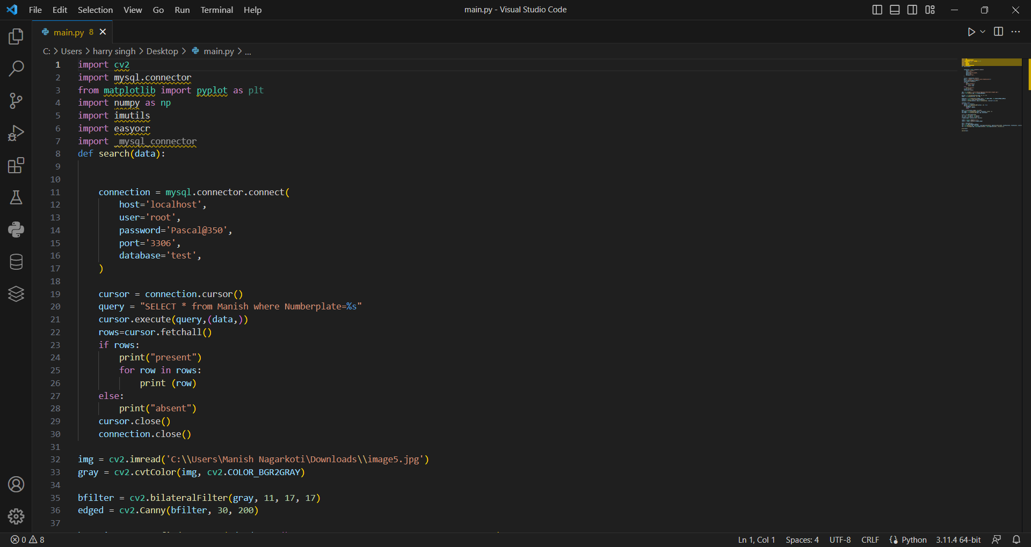

Slide 10
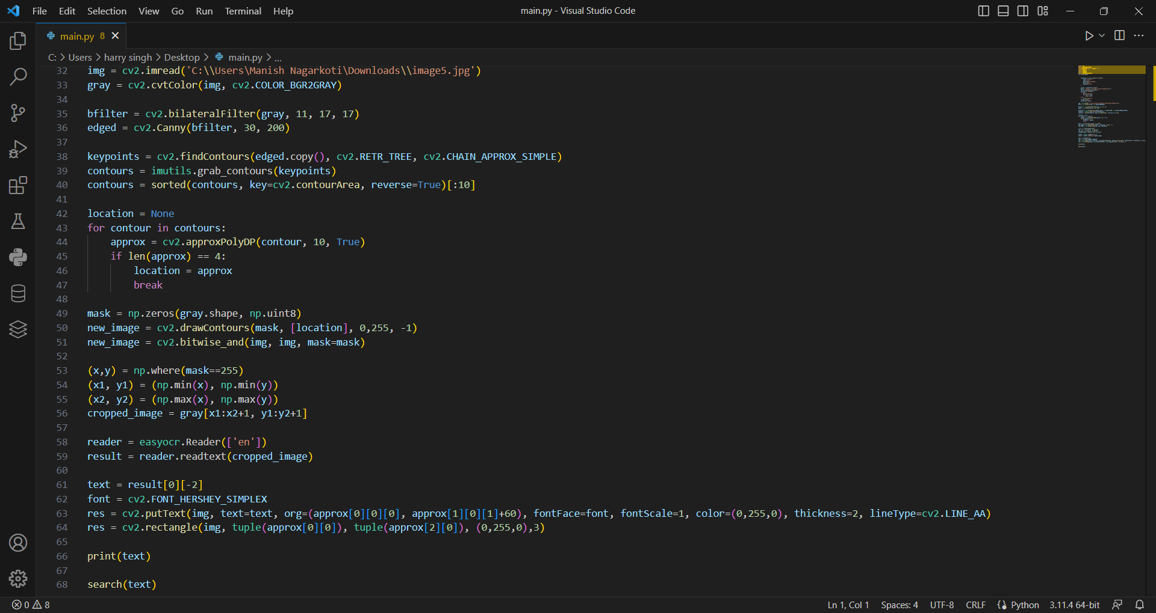

Slide 11
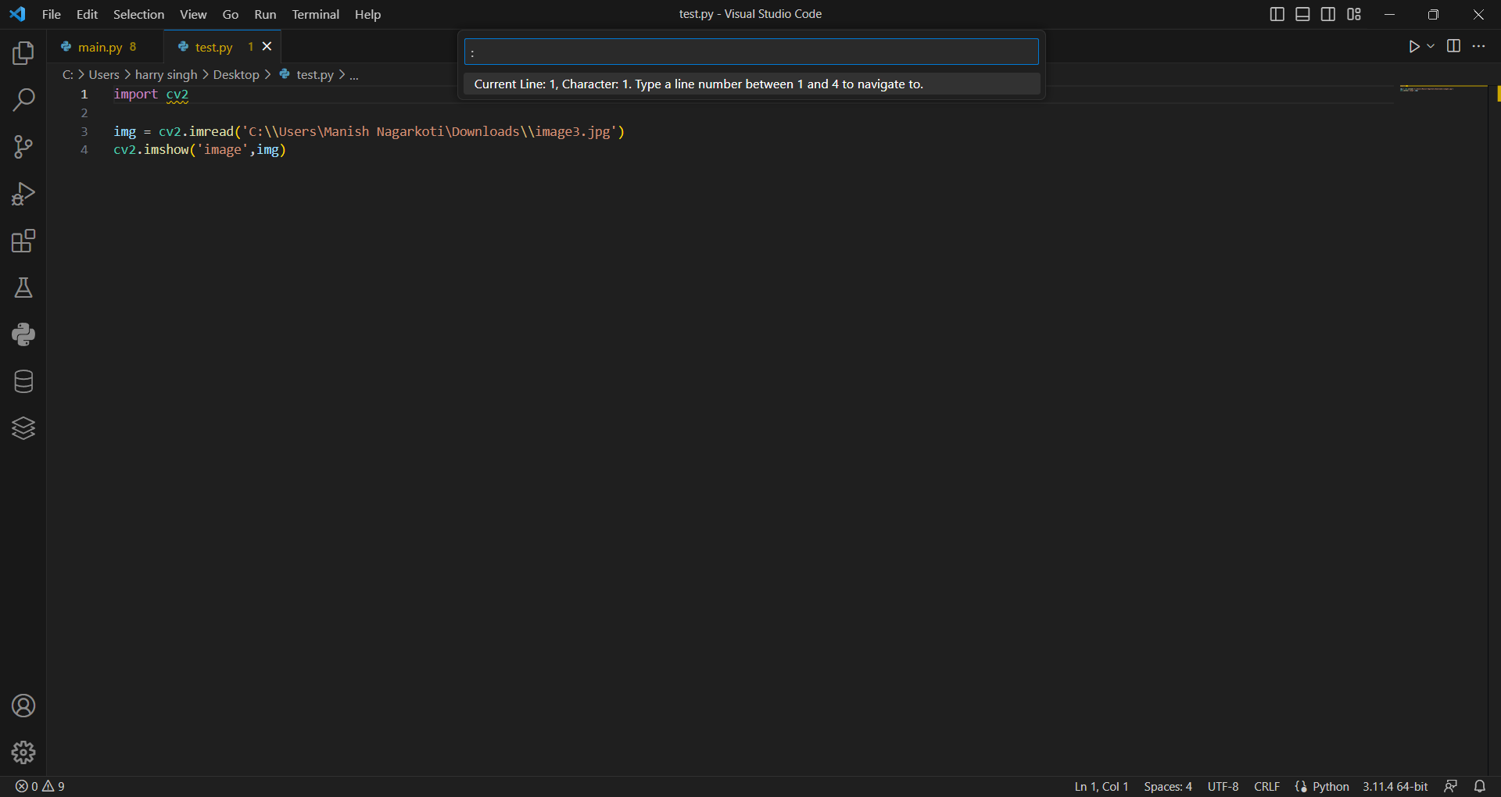

Slide 12
Thank YOU

